Slide 1

NSANGI CHRISTIAN FELLOWSHIP HISTORY
2006-2024
Philippians 2:15
“Home of Stars for Christ”
NCF@18

Slide 2
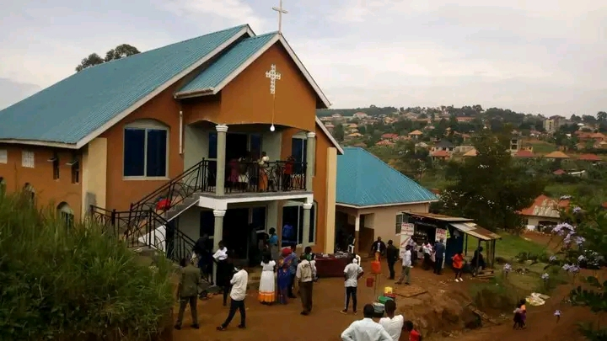
The Lord has been faithful. Thes 3:3

Slide 3

How this Church began.
In 2006 January , God sent me to Nsangi to start a Church , It was a deep small voice. I had no job, No money , No house but I had to obey God. I used to stay in Kyengera after my University Diploma in Education just 10 Kms to where the Church is situated now , So I started to walk on foot daily to pursue the vision.
One man in Nsangi provided a place where I placed our first temporary structure. I started with 3 people which I preached to and they received Christ Jesus. They were 2 Children and one lady. People began to join day by day. We started on 8th/March/2006. Today we are making 14 years of God’s grace.
GLORY BE TO GOD!!!
It began as a fellowship every Sunday Evening.

Slide 4
OUR LOGO
Taking the word of light to the world so that people may discover their value and shine as stars in this dark world.

Slide 5
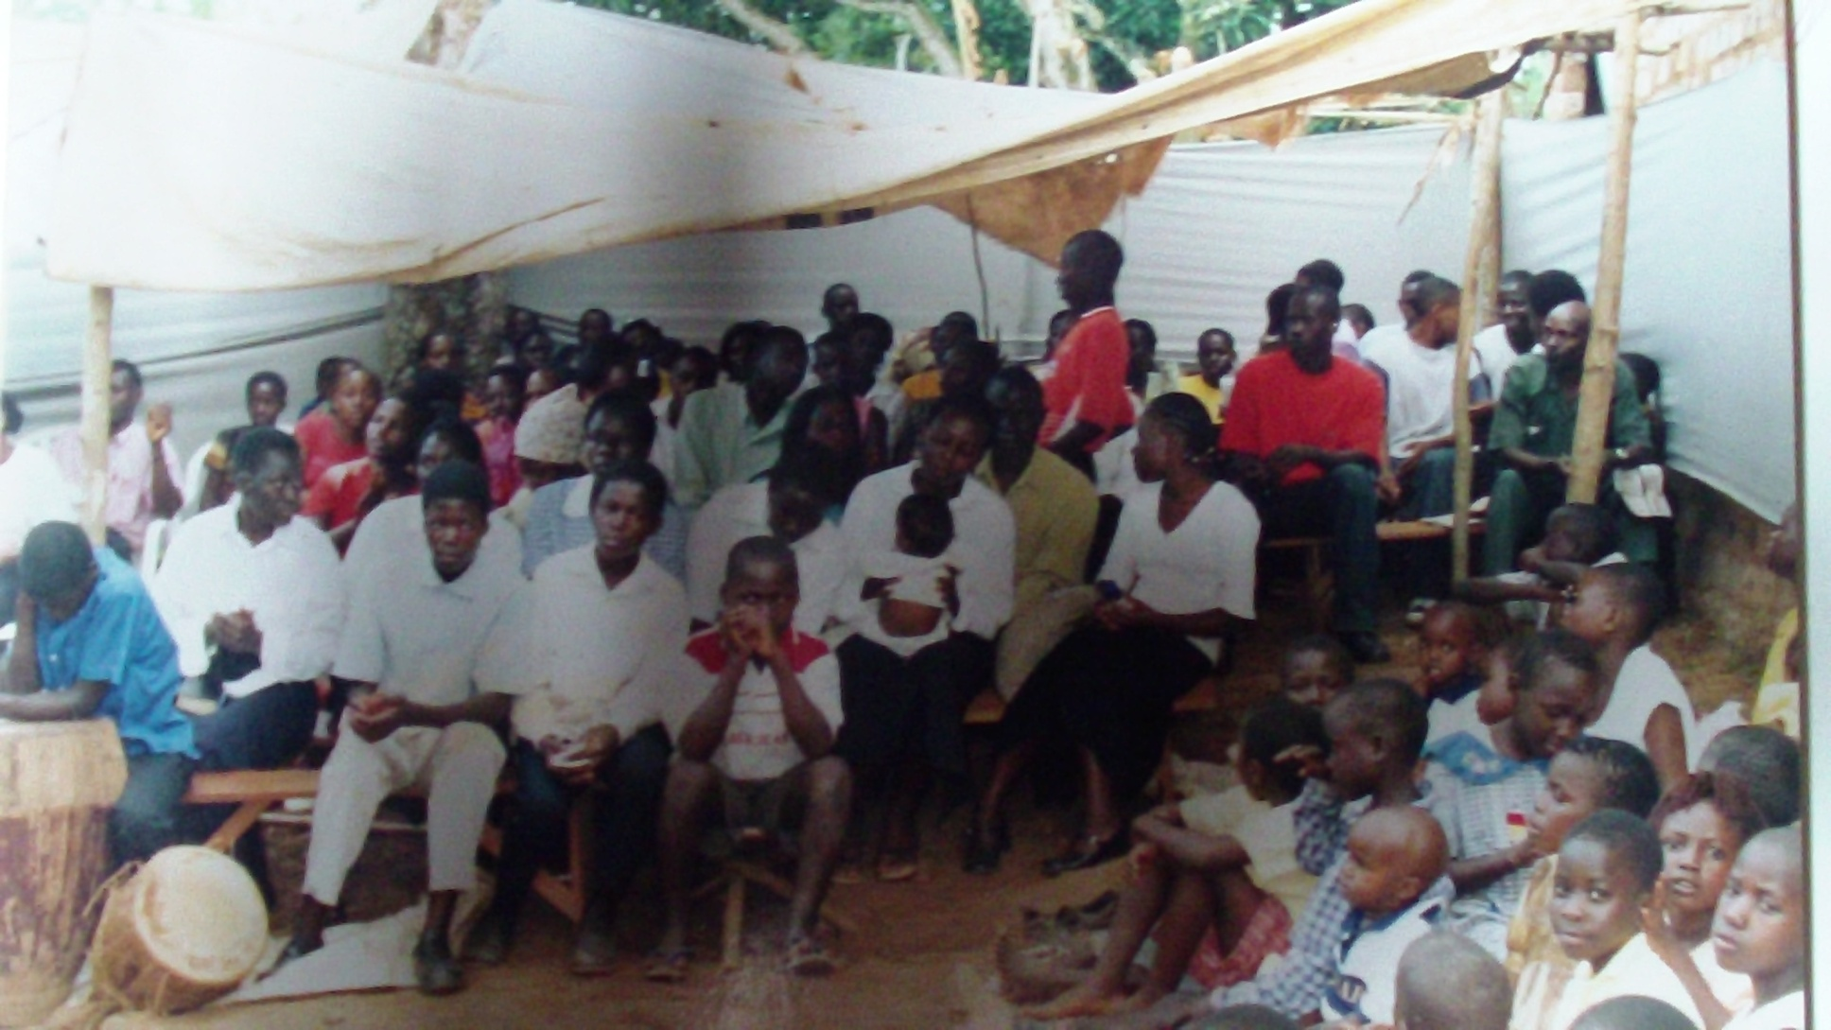
FIRST Church structure in 2006

Slide 6
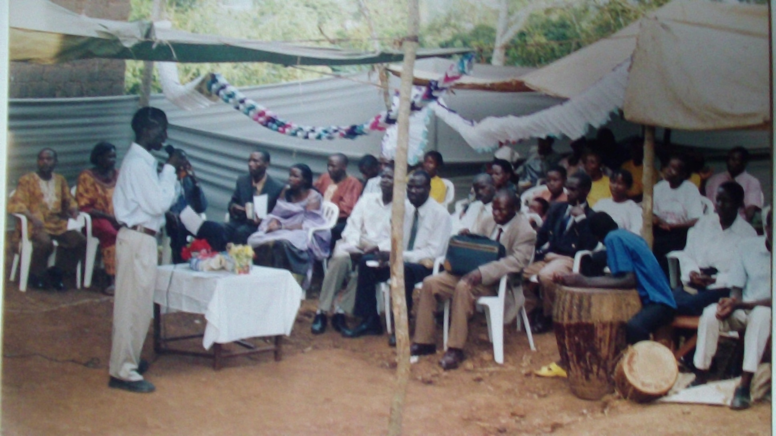
Pastor Kayongo during that time-Official opening-First Sunday worship in the evening. Local Leaders had also visited us that day with other neighboring Church members.
Mr. Kabanda and Mrs. Ssengendo attends prayers.

Slide 7
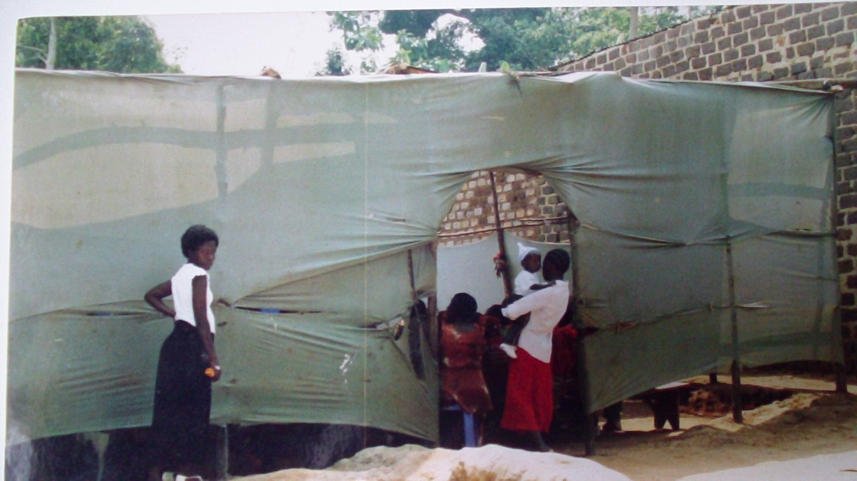
2nd Church Structure in 2007.
We used to roll our church with a cloth given to me by a friend.

Slide 8
What to remember
Our Church fell down
Pastor had to come every morning on Sunday to cover the church- Did everything till he trained these children
Church members had little hope and were mostly children
We could not afford a kilo of posho and beans
Only Pastor in 2007 had a phone
To take them to Kyengera every Sunday
A conman who promised us machines and chairs but God protected us.
Heavy rains disturbed us a lot.
The traffic police caught our vaehicle carrying our papyrus.

Slide 9
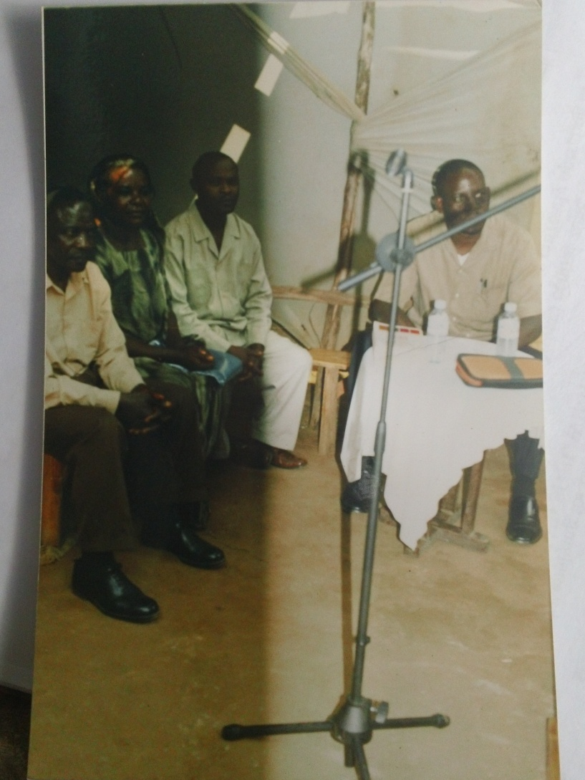
Chairman and Vice Chairperson of Nsangi Central zone visited us on Sunday in 2007.

Slide 10
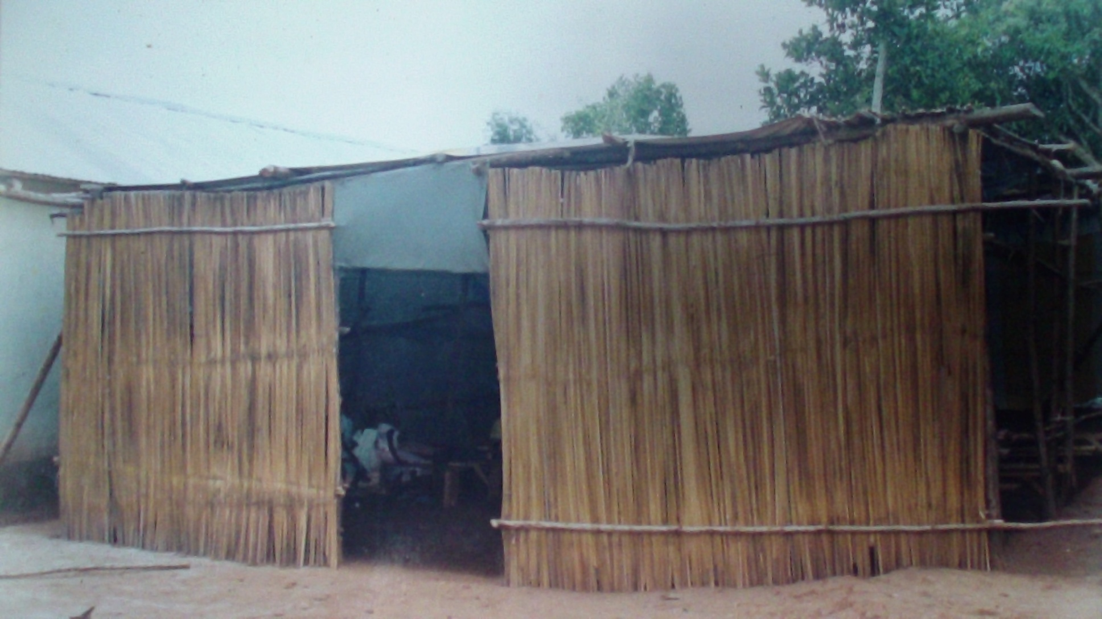
4th Church Structure.
This church fell down due to heavy rainfall which weakened the poles

Slide 11
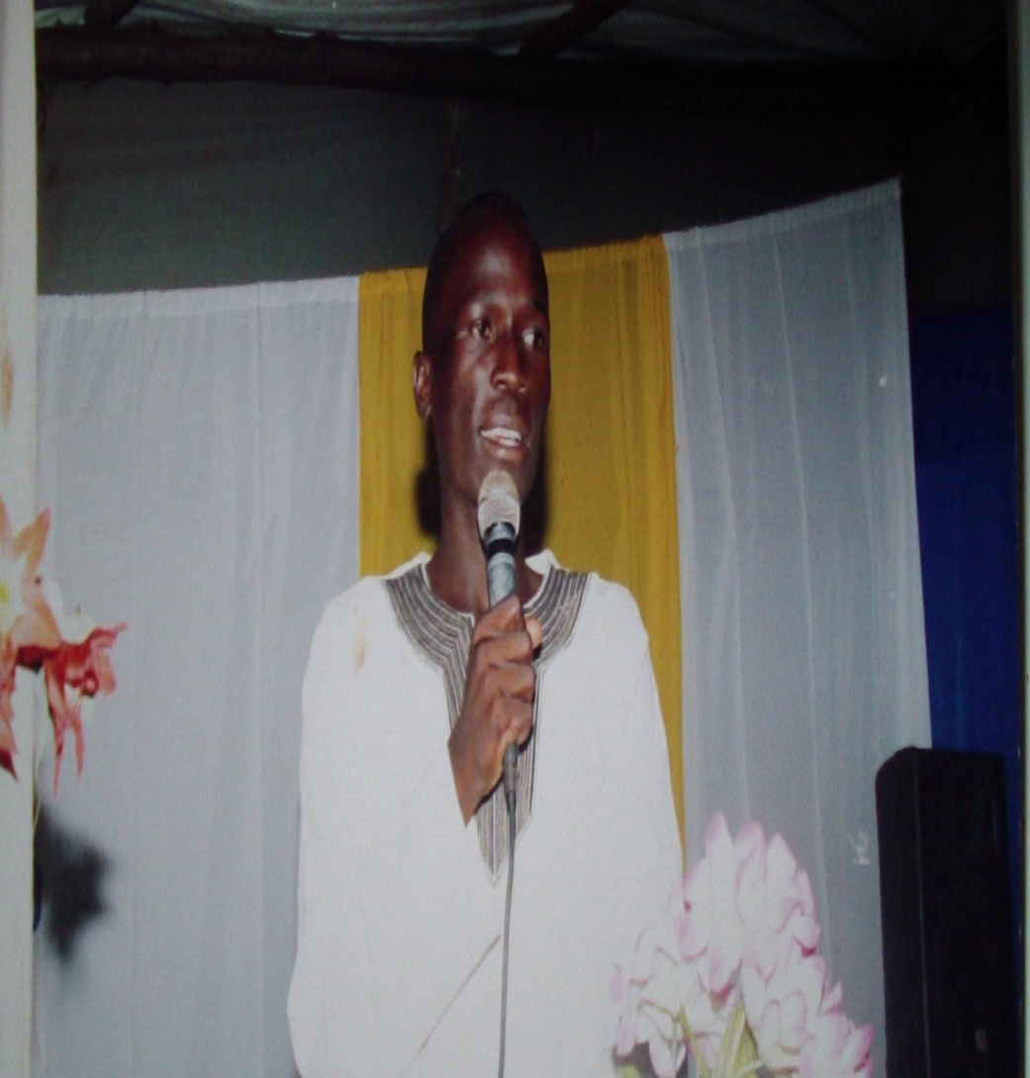
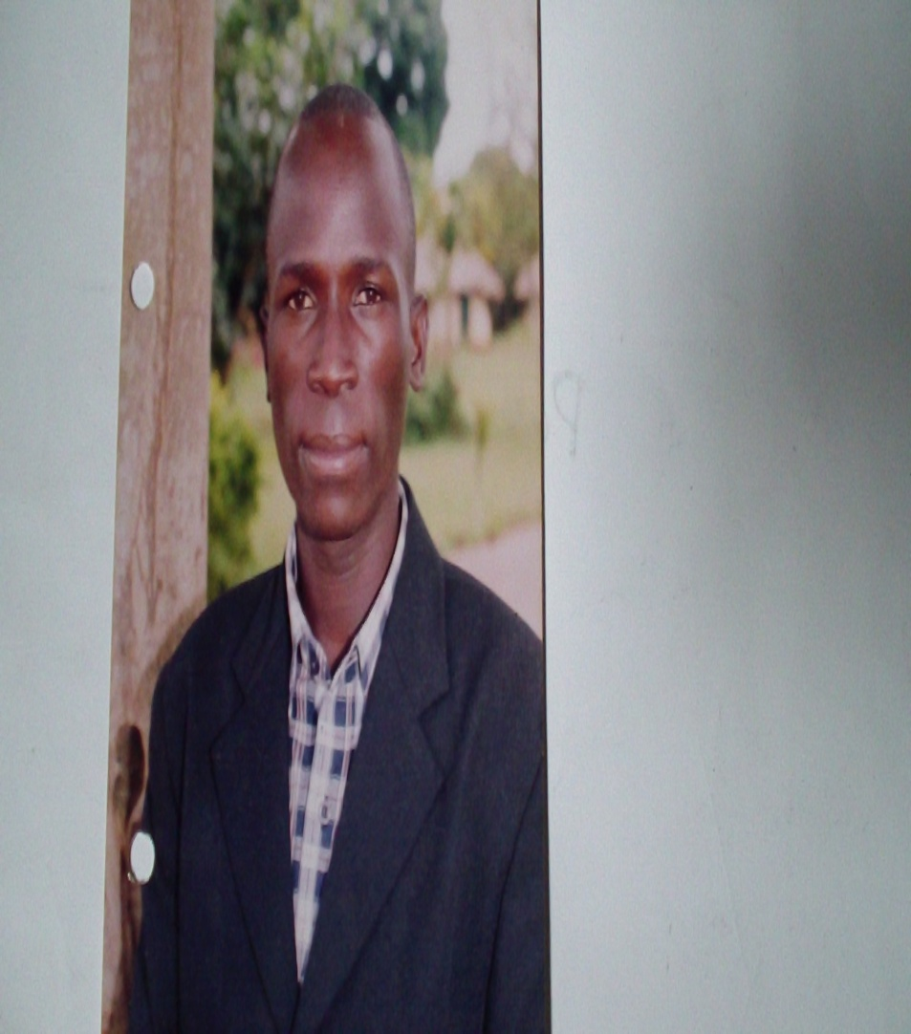
Pastor Kayongo 2007
This time I was a school head teacher at Muzinda

Slide 12
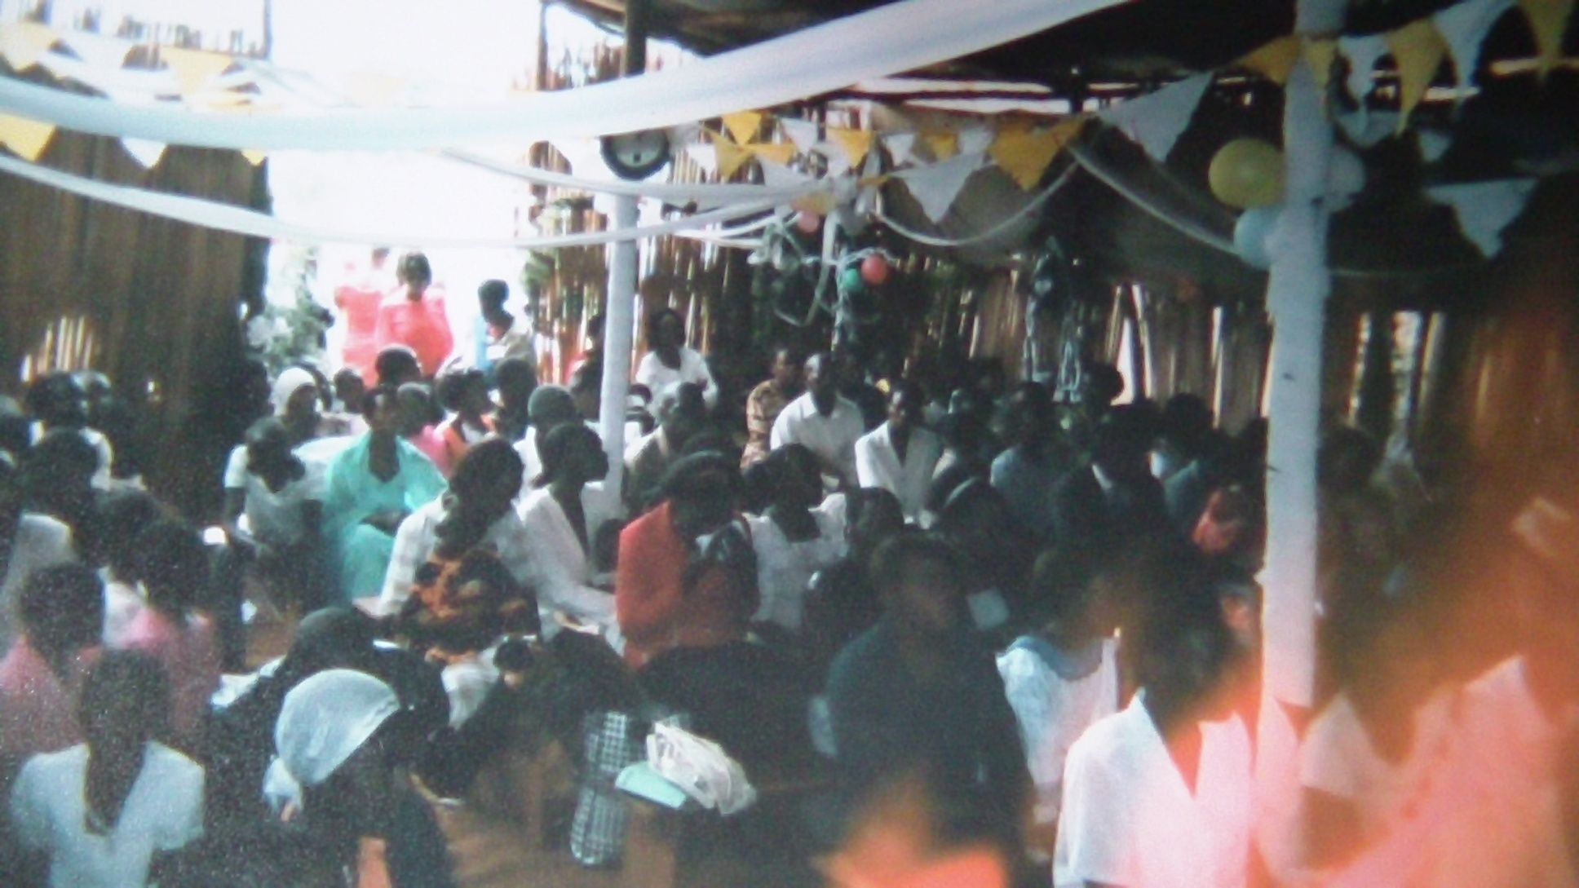
Thanks giving service during that time-We hosted many people
REGARDLESS OF THE CONDITION, THANKS GIVING WAS A PRIORITY.

Slide 13
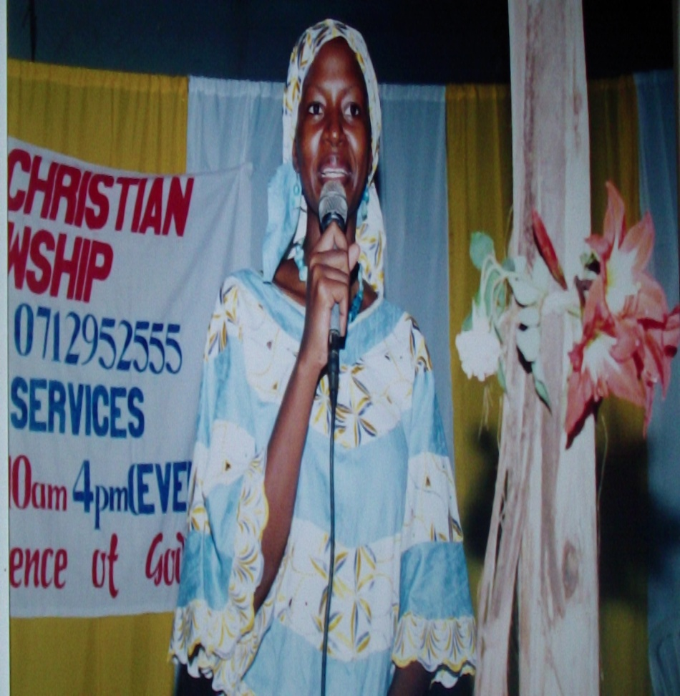
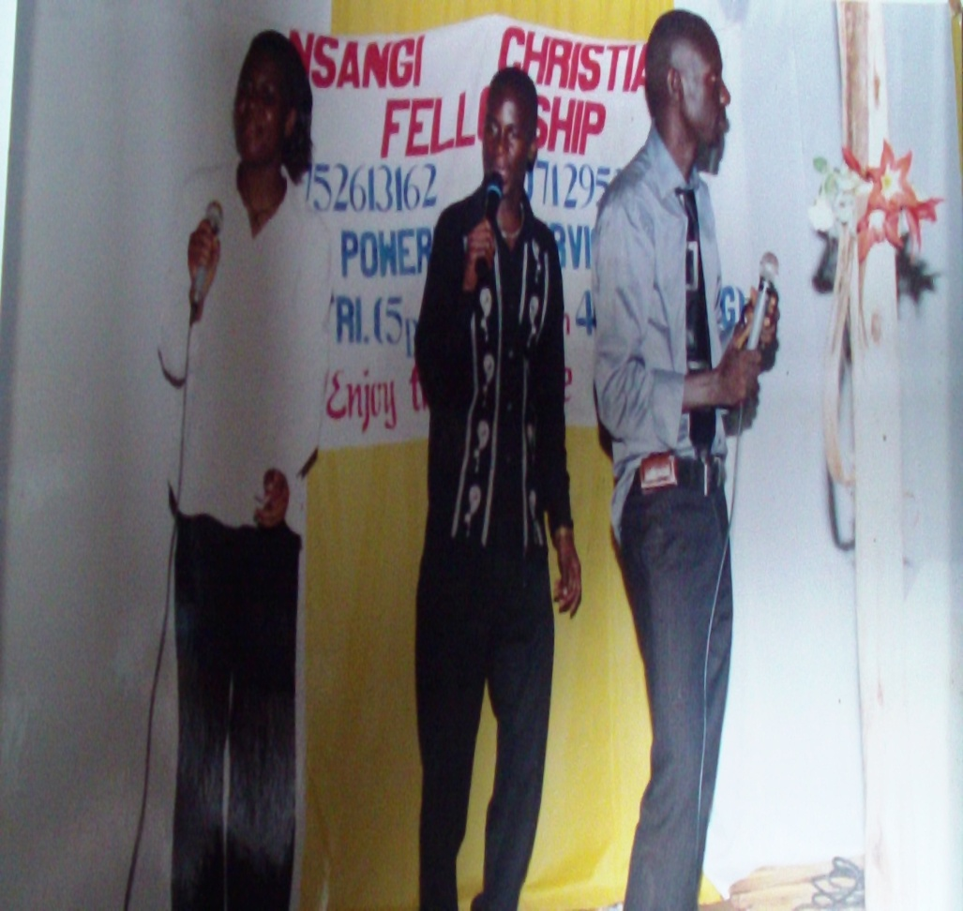
We hosted our area Member of Parliament Suzan Nakawuki, Pr. Wilson Bugembe-National Gospel artist in Uganda and other Pastors on the launch of our Church in 7th May, 2007.
The church launch was held on 7th.May.2006

Slide 14
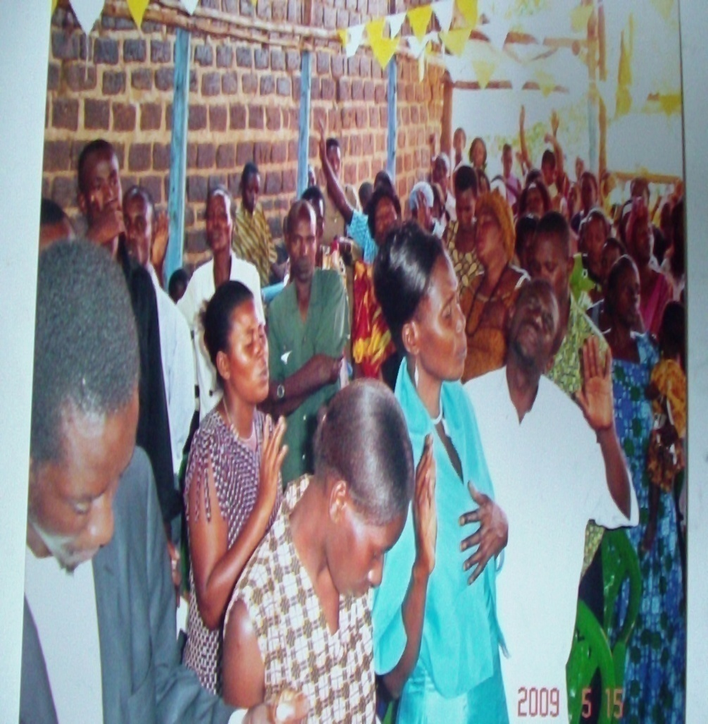
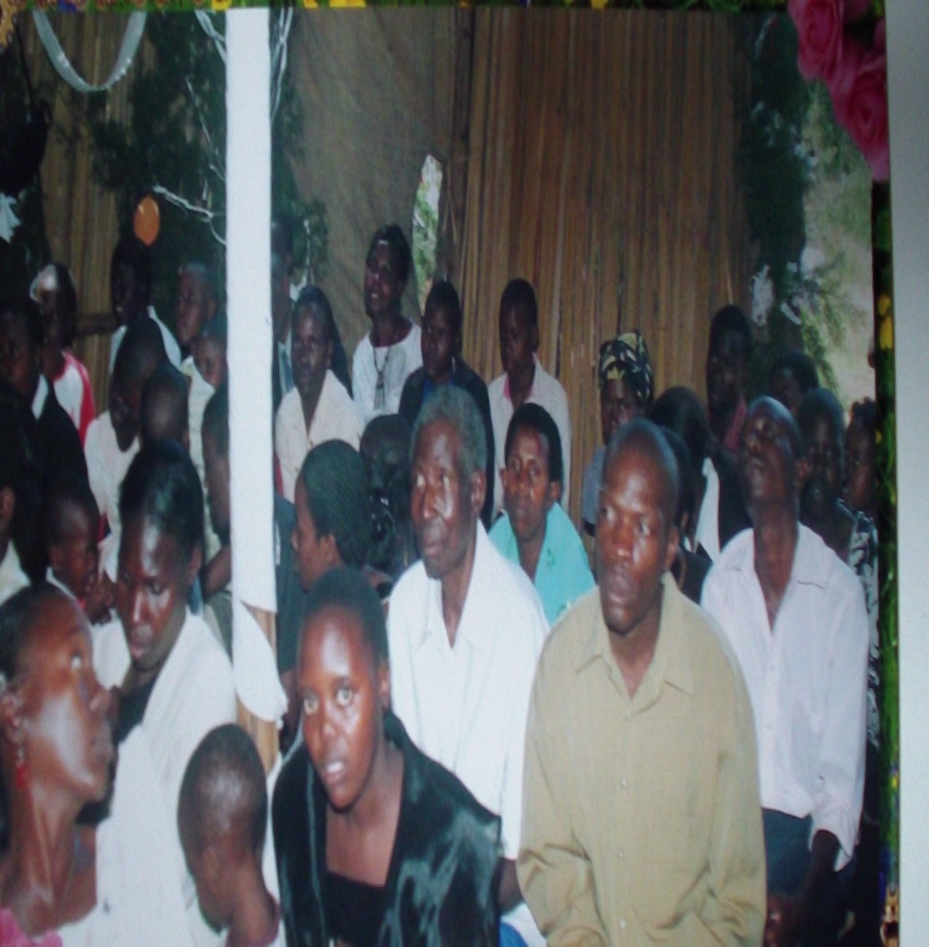
Hosting other Church members in our neighbourhood.

Slide 15
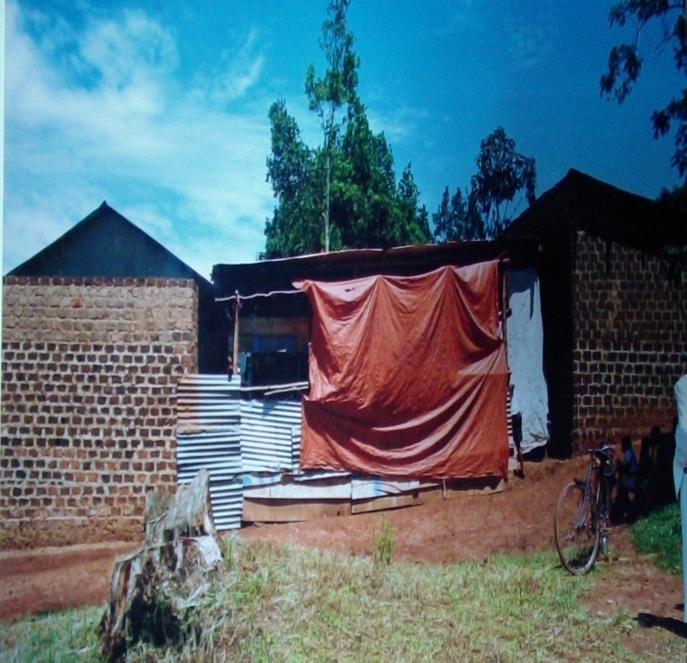
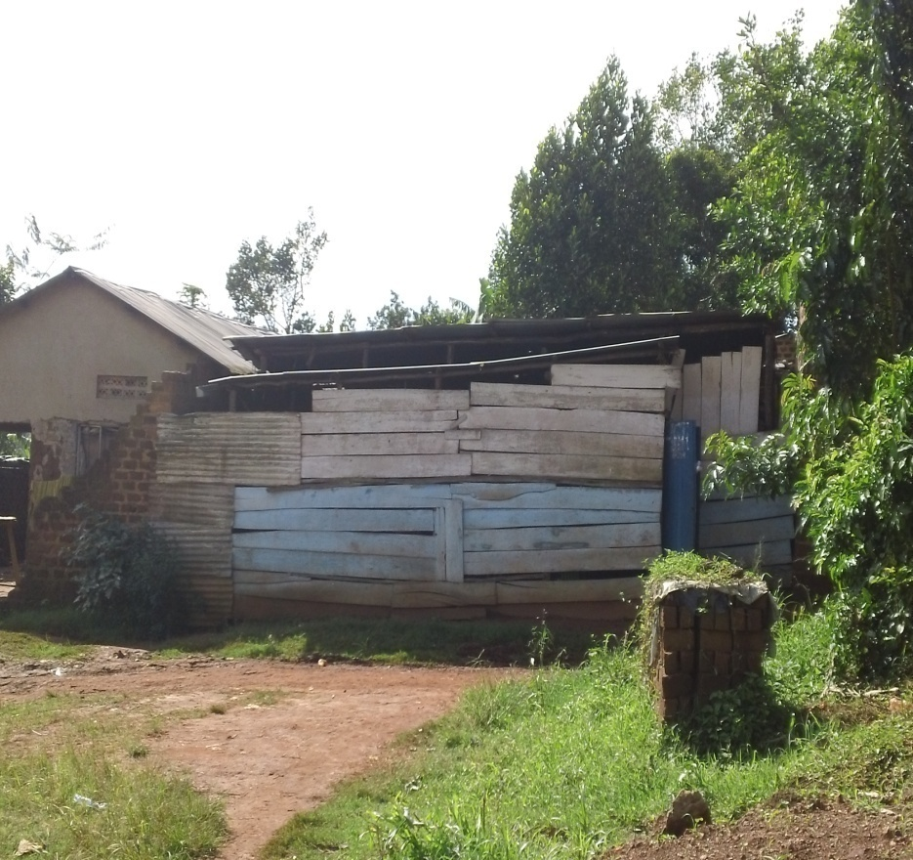
Our 5th Church Structure in 2009-2012.
God provided money for building this church miraculously when I obeyed the Holy Spirit

Slide 16
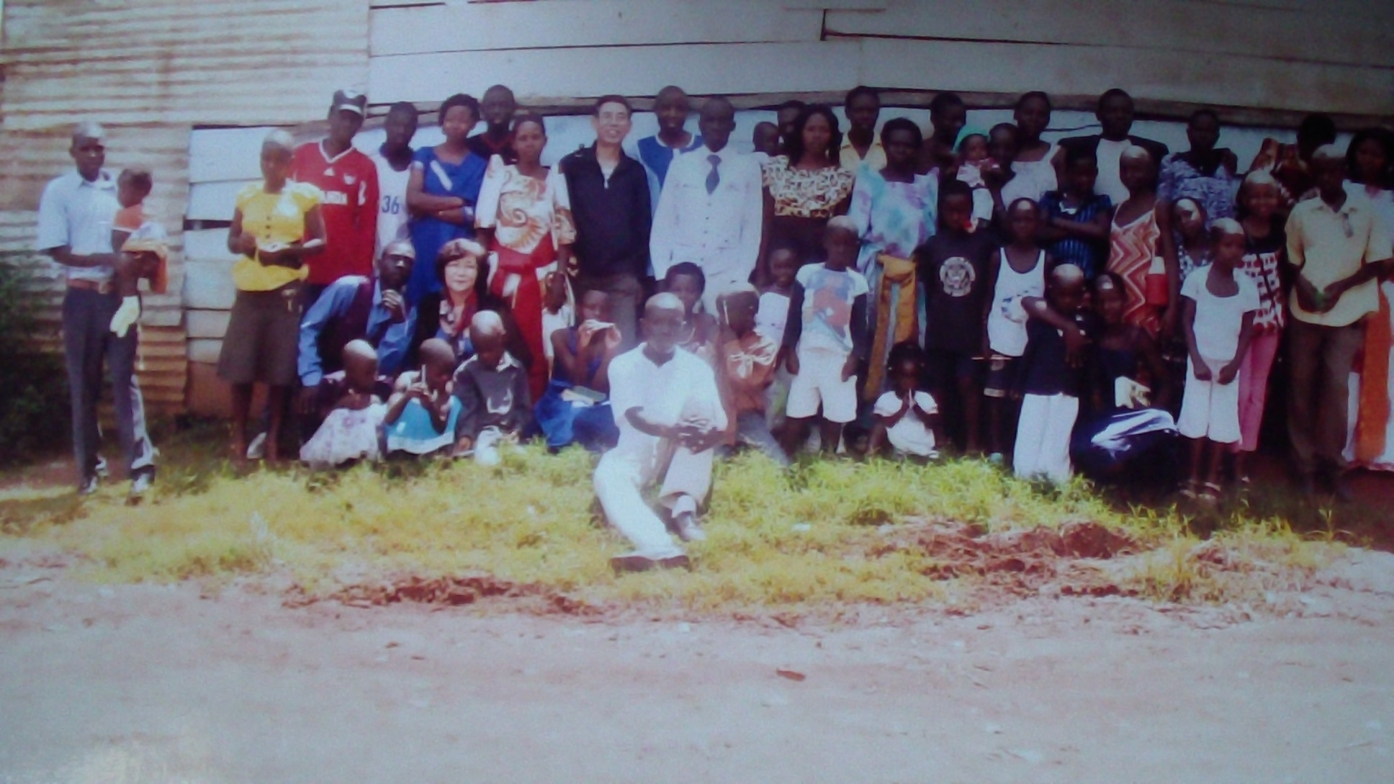
2012 CHRISTMAS DAY-GROUP PHOTO

Slide 17
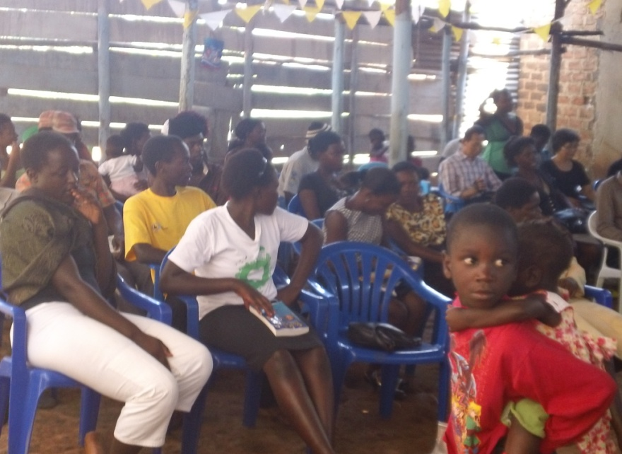
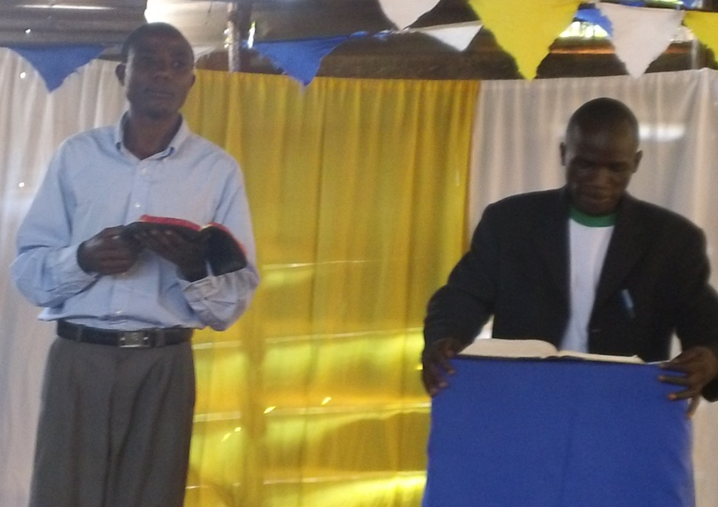
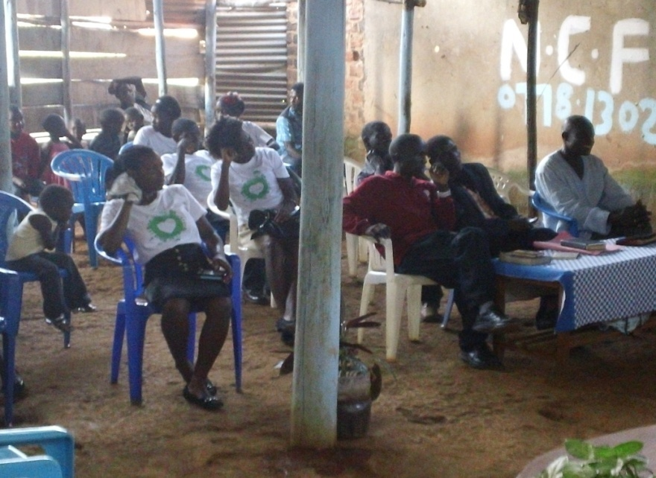
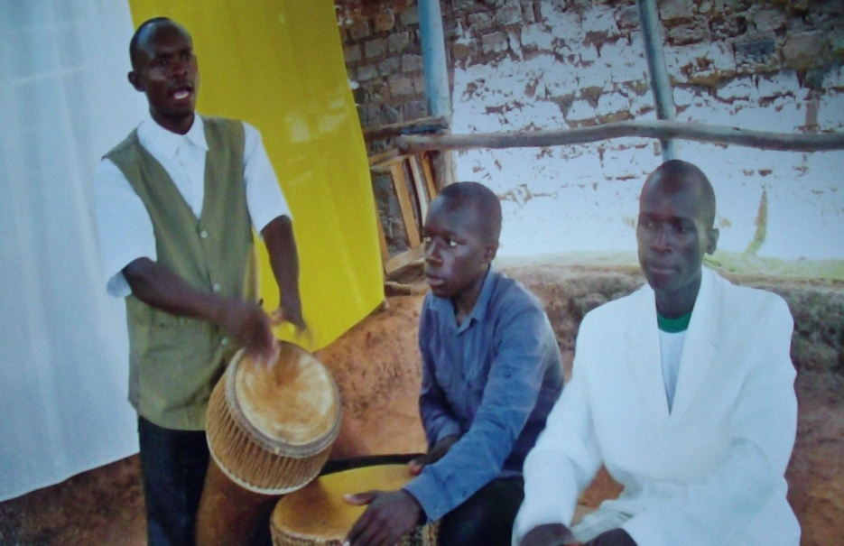
Some services in 2012.

Slide 18
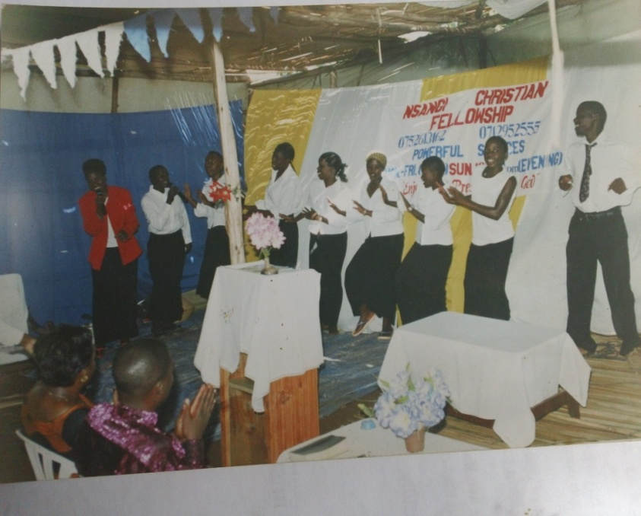
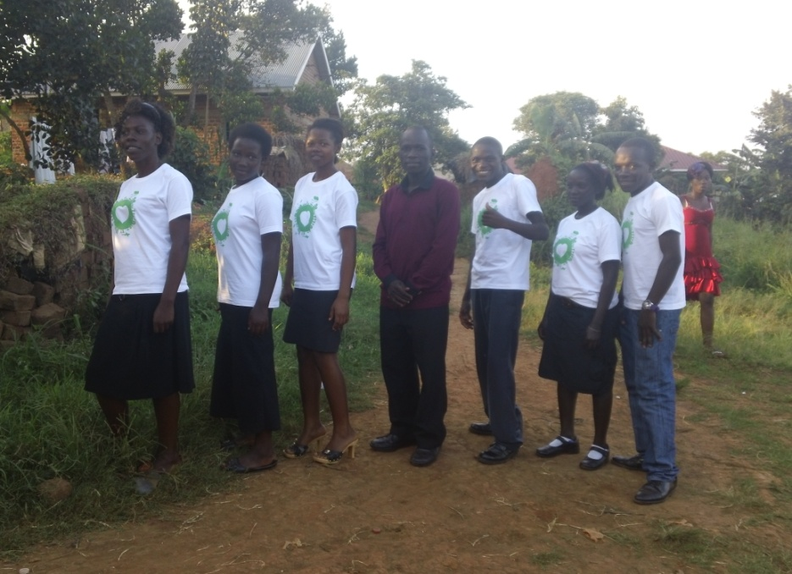
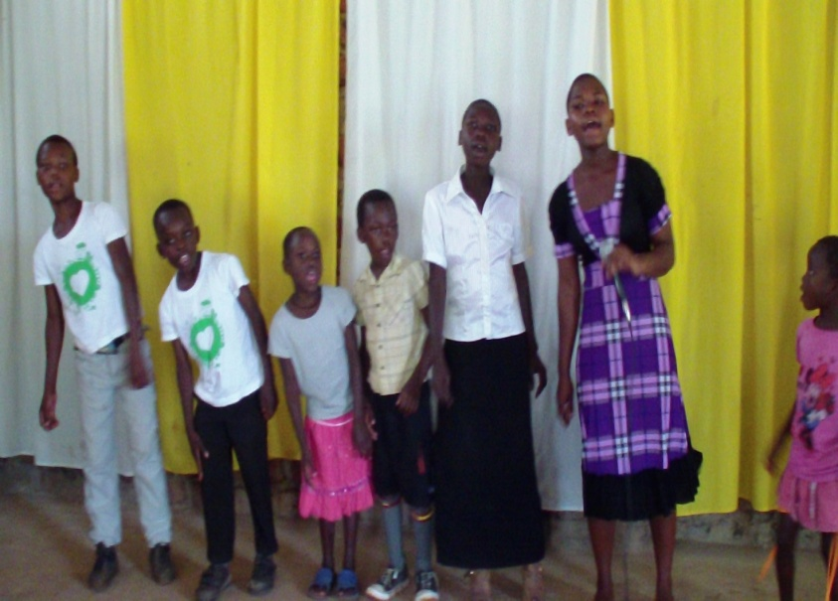
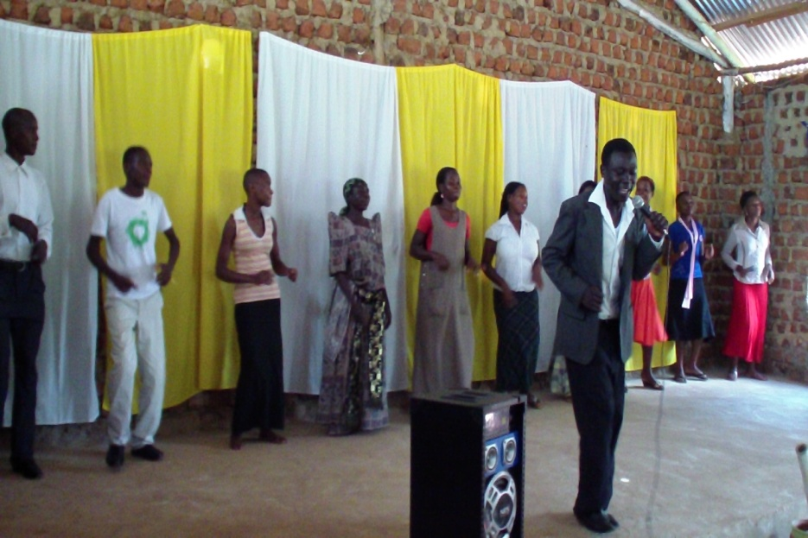
Some Music groups then.
2007
2013
2013

Slide 19
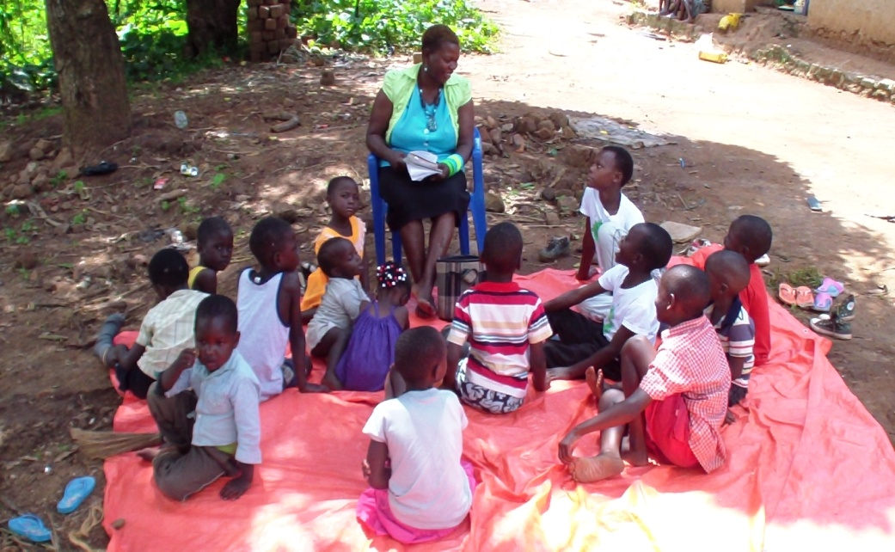
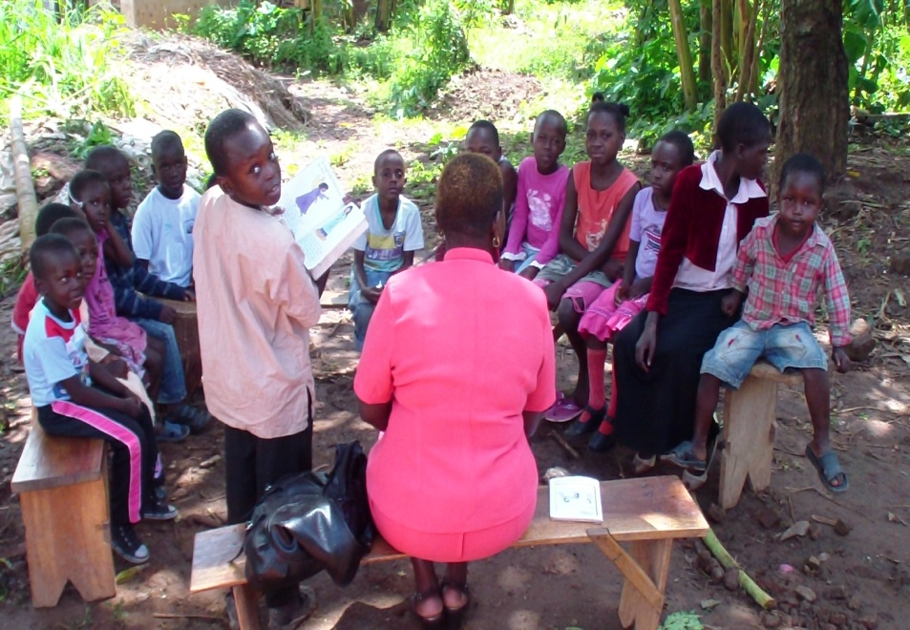
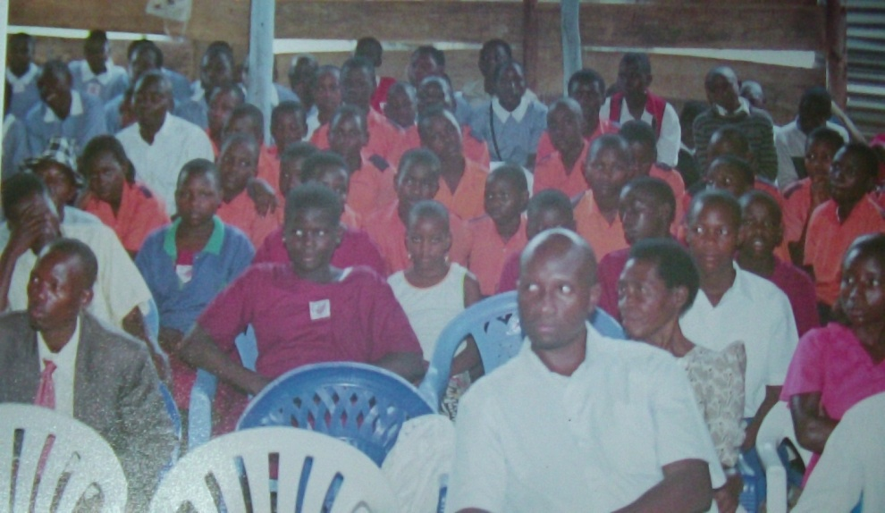
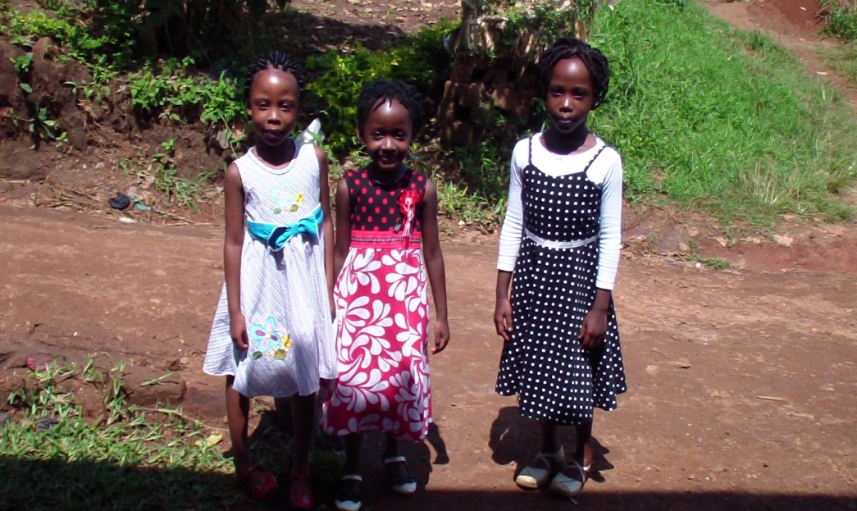
SUNDAY SCHOOL-CHILDREN CHURCH in 2013
“Let the Children come to me”.

Slide 20
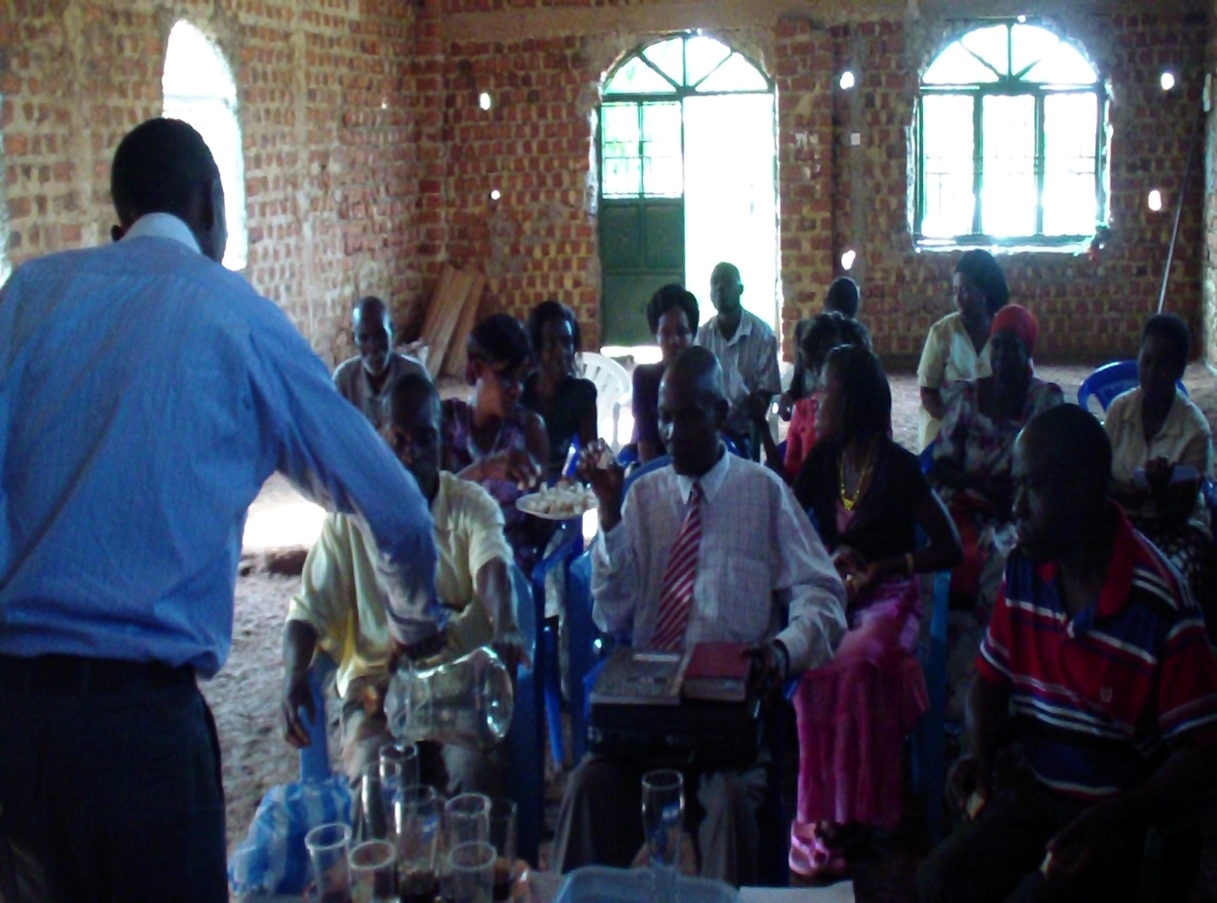
SOME BIBLE COLLEGE STUDENTS-DIFFERENT PASTORS-STARTED IN 2013 JULY.
STUDENTS DURING HOLY COMMUNION IN NOVEMBER 2013.

Slide 21
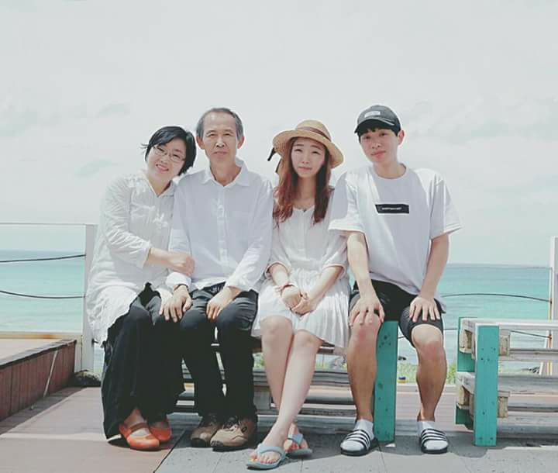
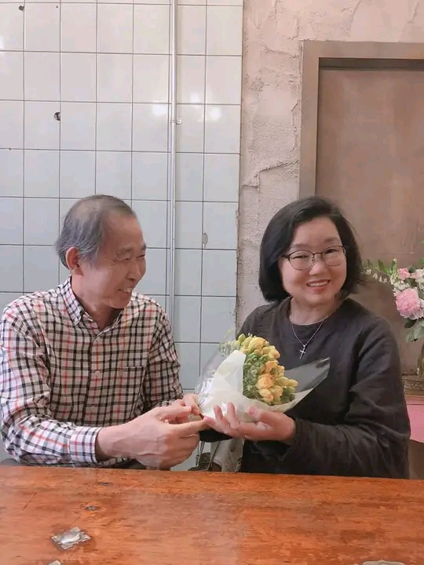
Missionary Ko and Mama Esther Joins us in March, 2011.

Slide 22
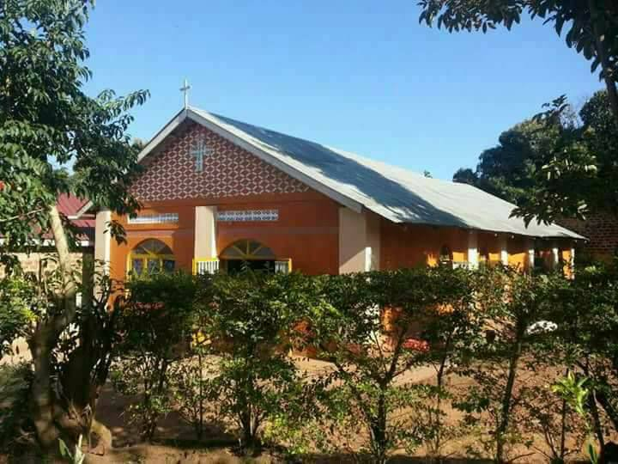
6TH Church

Slide 23
7th Church as of 2004

Slide 24
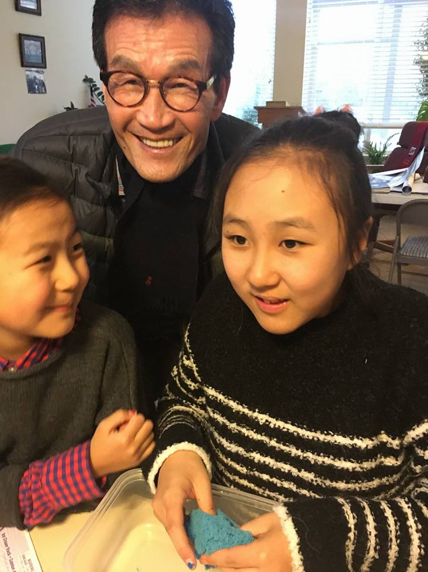
Dr.Mok. Young Soo Mok Joins us in February, 2015 with Wycliffe

Slide 25
NCF Branches now:-
We have established 20 Church branches with in different parts of Uganda.
300 Churches subscribe under our ministry Fellowship in different regions of Uganda.
We have ordained 56 Pastors, Deacons, elders

Slide 26
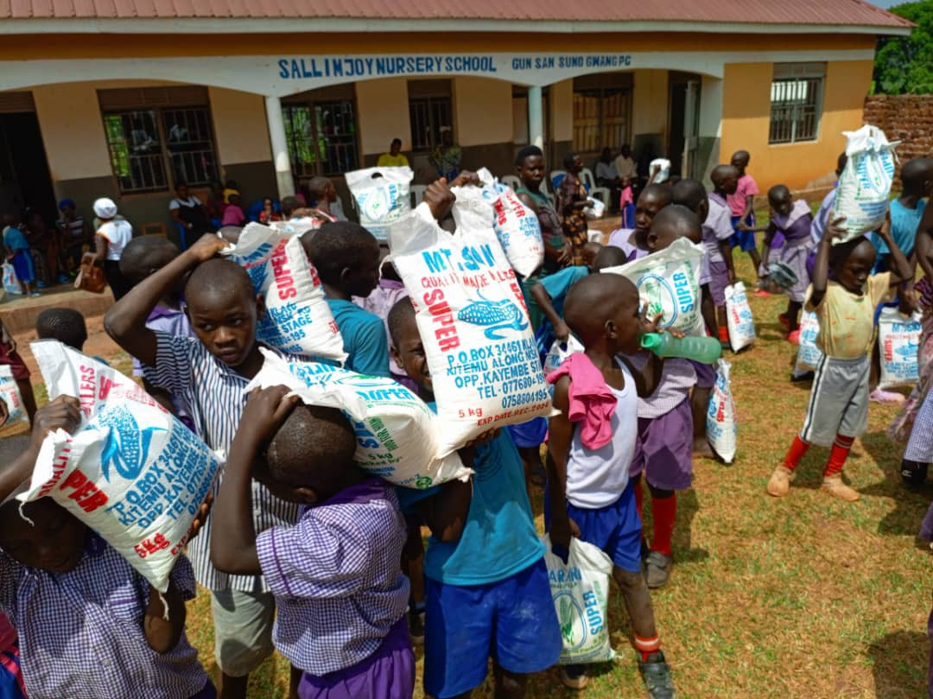
Community Support

Slide 27
Schools
Home of Stars Kindergartes and Primary School-Mpigi
Bulyasi Vocation School-Mpigi
Sallim Christian Junior School-Nsangi
Sallim Christian High School-Kanyale
California River Of Life University
Uganda SMU Mobile School

Slide 28
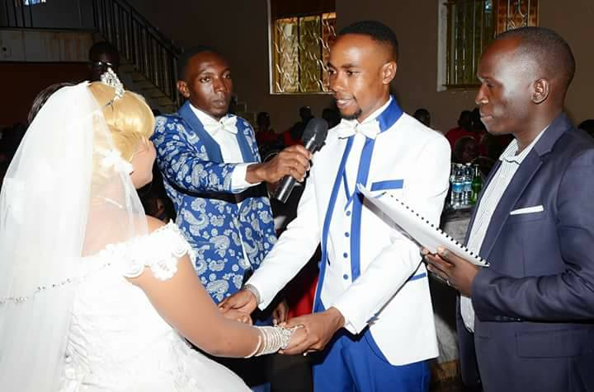
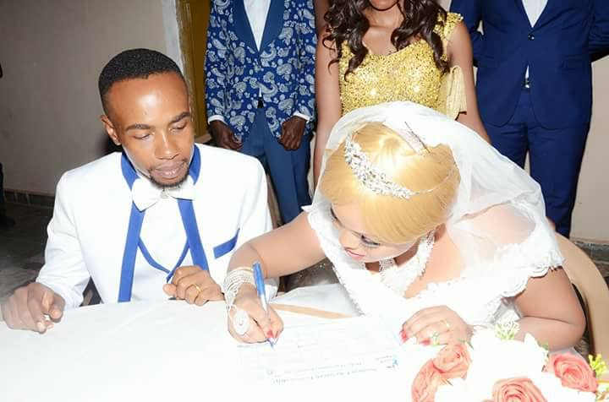
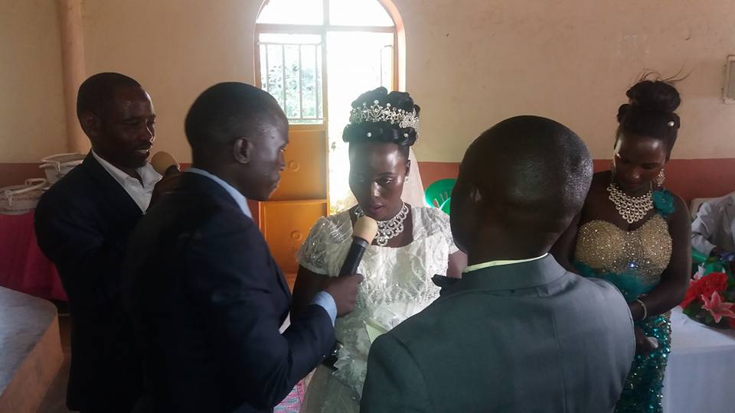
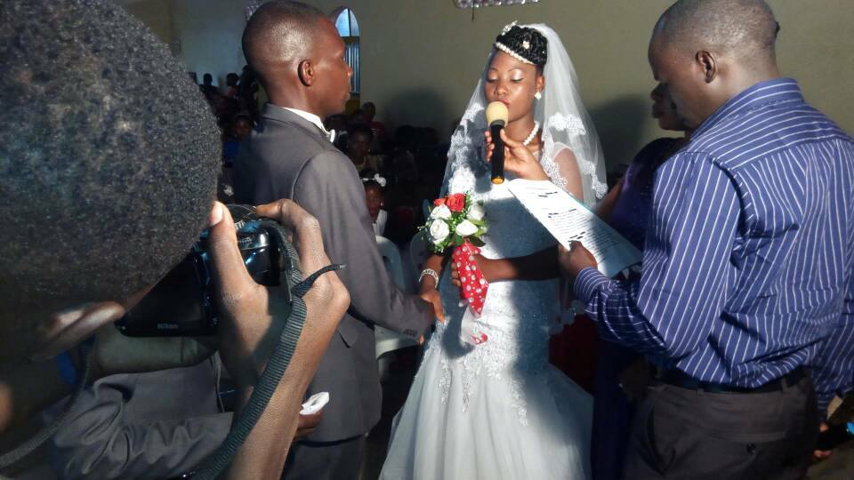
Officiated 106 weddings.
We have so far cerebrated 106 weddings since 2006.

Slide 29
Churches we have supported in construction
Through Wide Love World we have constructed 66 Churches in Uganda.

Slide 30
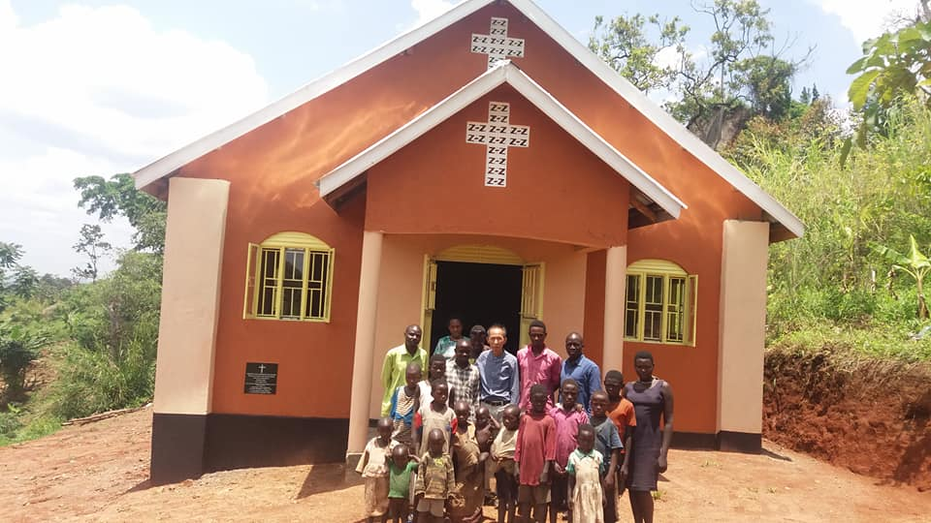
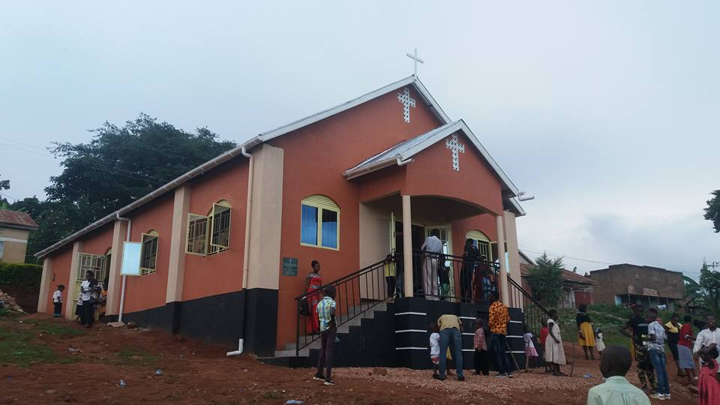
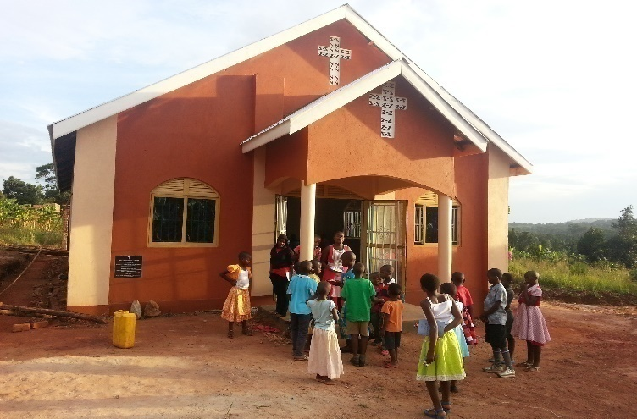
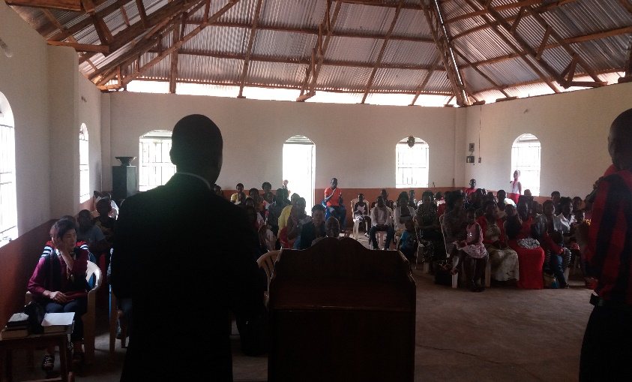
Church Construction.
KITONYA C.FELLOWSHIP, 2018
OPEN HEAVEN CHURCH MPIGI,
MPIGI C.FELLOWSHIP, 2017
Mbuya

Slide 31

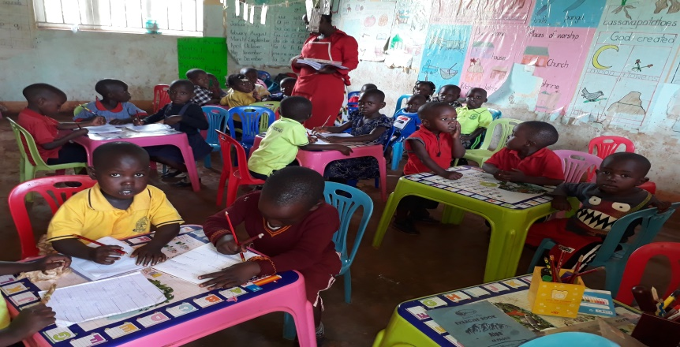
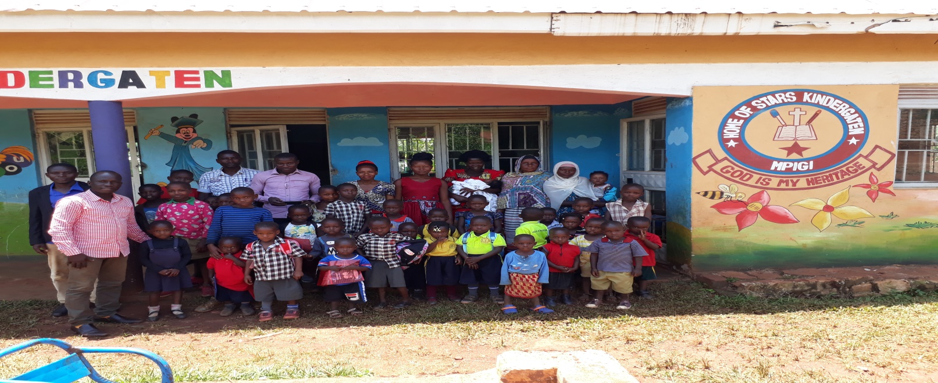
Ministry Projects:
2018 OPENED UP HOME OF STARS FOR CHRIST, MPIGI-KALAGALA, 2020

Slide 32
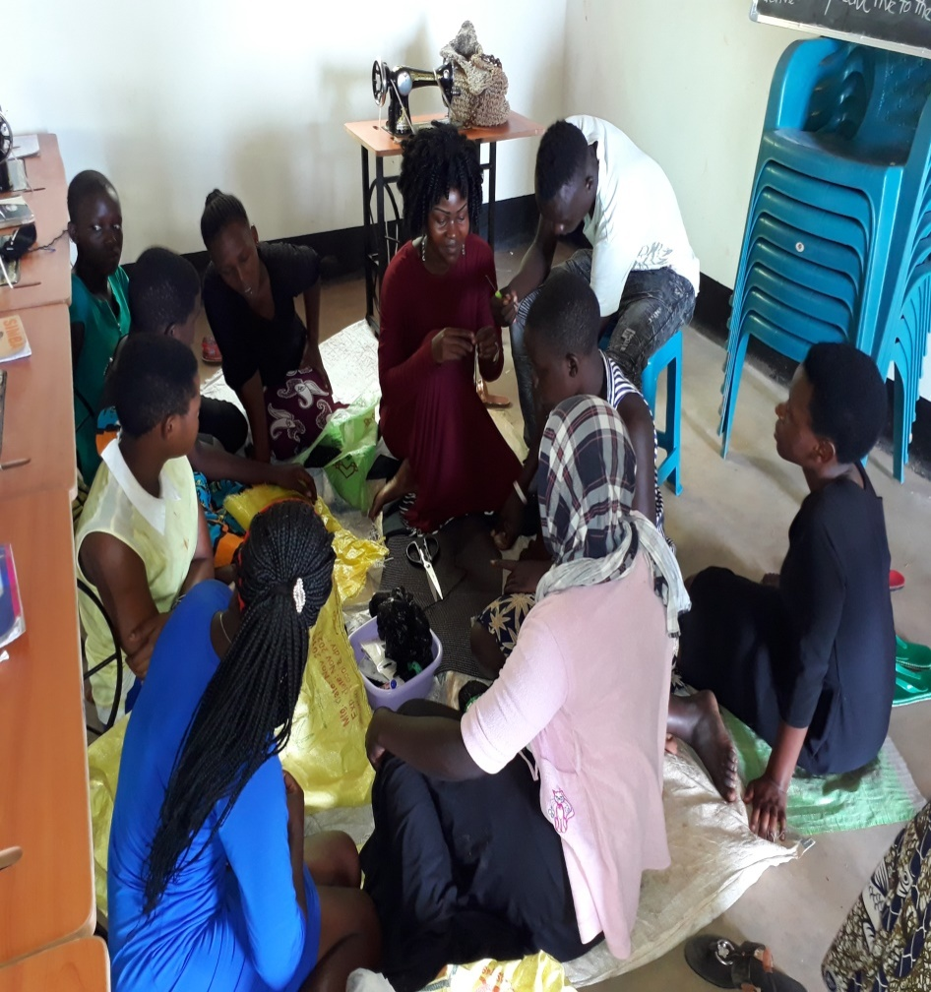
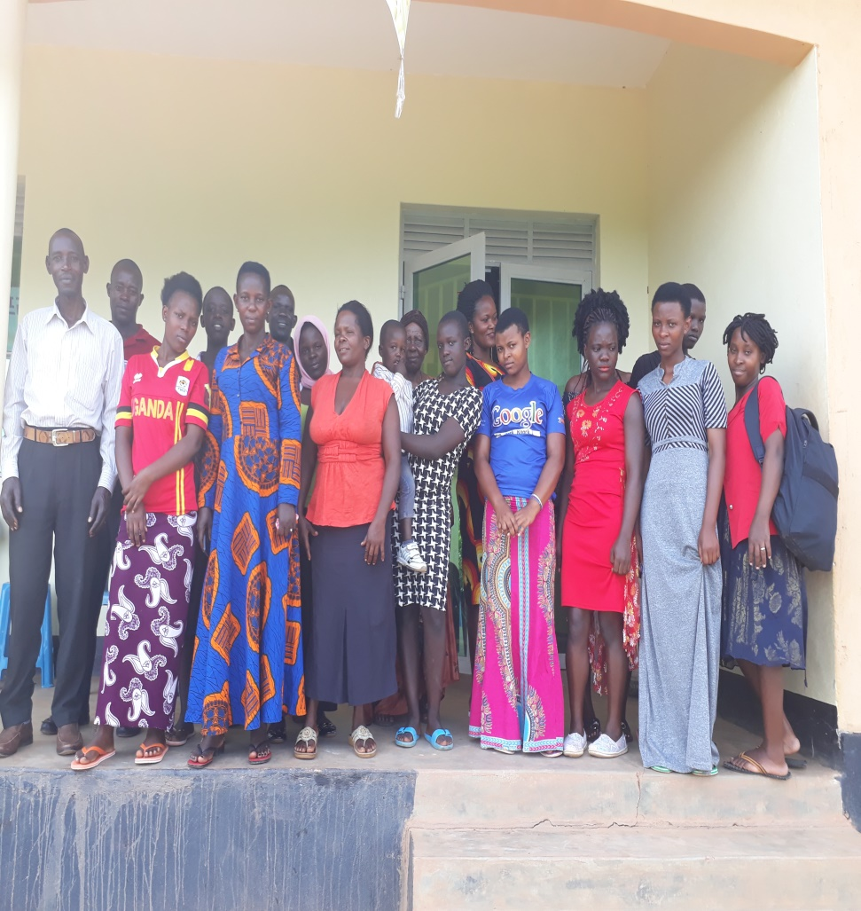
Home of Stars Vocation Institute
“ Love World Center-Bulyasi, Mpigi”

Slide 33
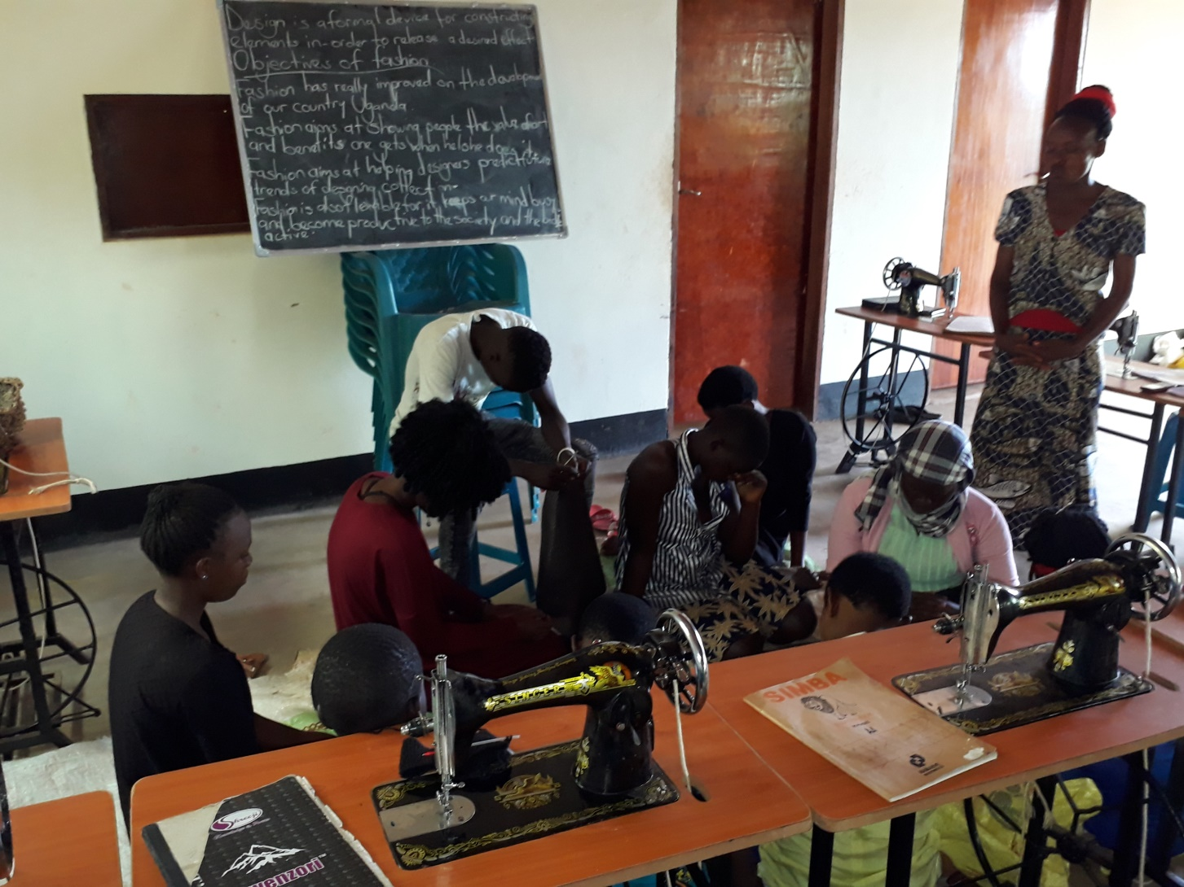
VOCATIONAL SCHOOL

Slide 34
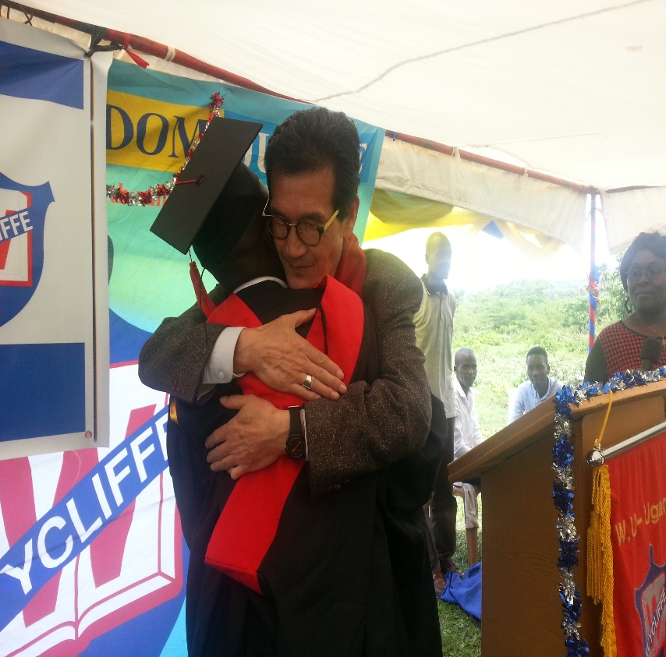
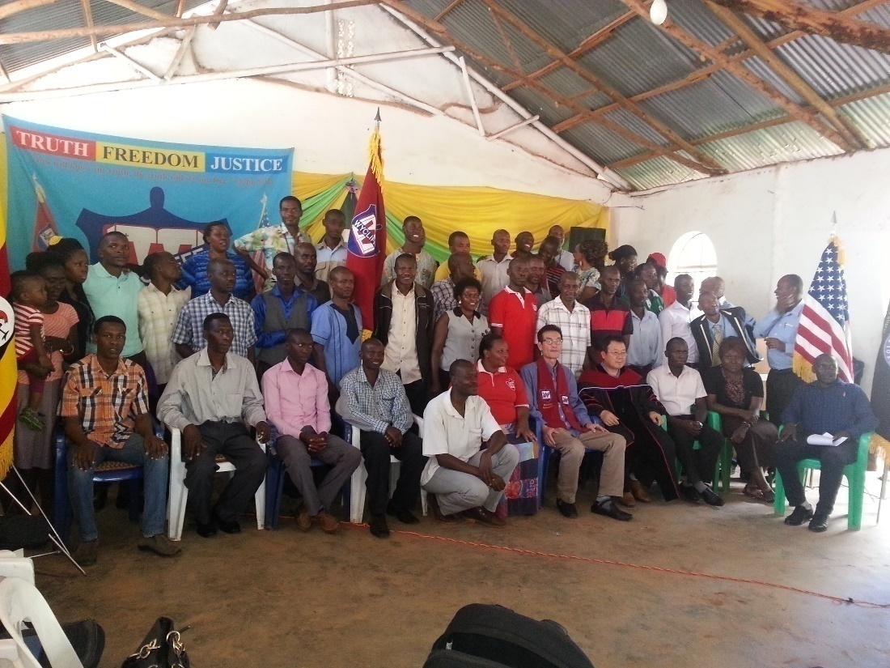
WYCLIFFE UNIVERSITY
Our dream for the University came true when we opened up Wycliffe University in 2015

Slide 35
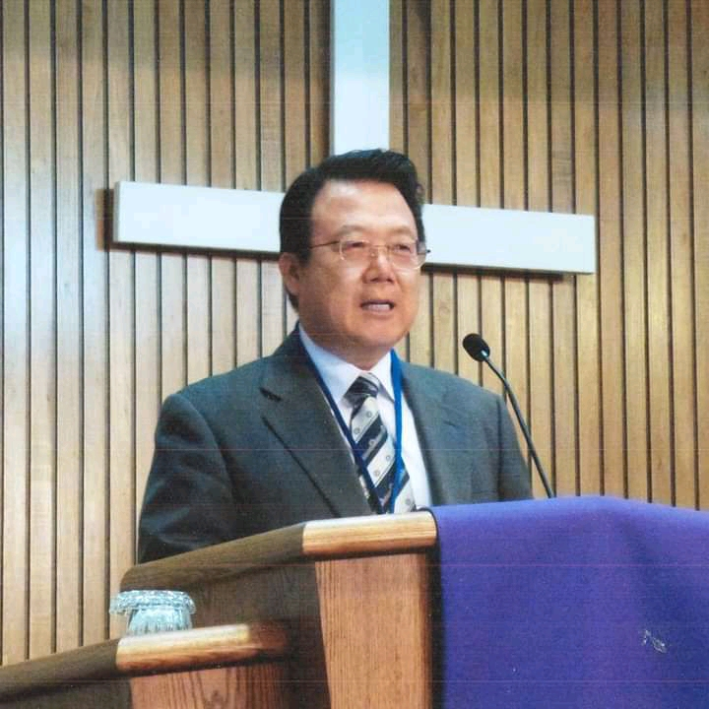
Dr.Jin Kim Joins us.

Slide 36
Califonia River of Life University 2021
Currently we have 9 Campuses country wide with over 300 students.

Slide 37


Home of Stars Kids , Children ministry
Christmas Service organized every Boxing day

Slide 38




Home Of Stars Youth Ministry

Slide 39
What has helped us since 2006
Doing ONLY what God has told us to do-The assignment.
Being content
Teaching the balanced word of God
Raising ministers
Believing in others and respecting them
Working with other churches and ministries
Supporting and helping other people’s dreams and visions- No Competition.
Maintaining our programs that are successful
Prayer
Faith in Action and ignoring despisers.

Slide 40
Thanks
God the father, the son and the Holy Spirit.
My Family
NCF Church members
Our friends from Korea and USA
Fellow Pastors of NCF and friends.

